Slide 1

WAY TO ENTERPRISE
AWS
VTI ACADEMY
Author: duy.nguyenngoc1@vti.com.vn

Slide 2
Agenda
EFS Service
S3 Service
Assignments
Quiz
Copyright © VTI Academy All Rights Reserved

Slide 3
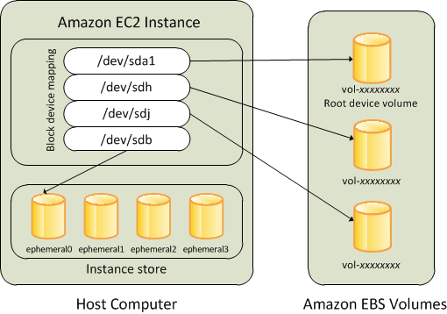
EC2 Storage
Storage service for EC2
  EC2 Instance Storage
  EBS
  EFS
  FSx (Next lesson)
  S3
  Database (Next lesson)
Mapping volume to folder into instance

Slide 4
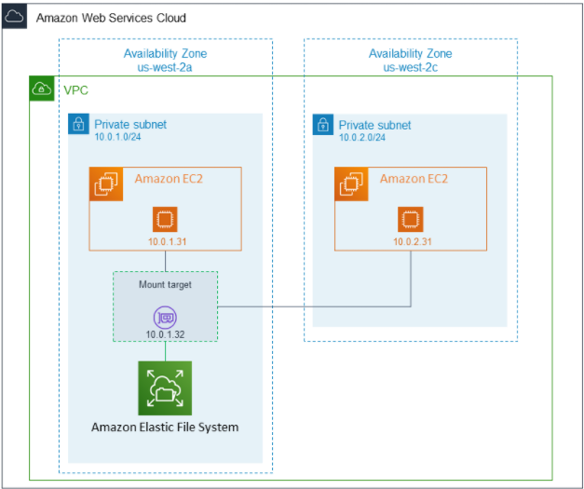
EFS Service
Stands for Elastic File System
Managed NFS (Network File System) that can be mounted on many EC2
Usecases: sharing data between instances, content management, web serving, ...
https://docs.aws.amazon.com/efs/latest/ug/whatisefs.html

Slide 5
EFS Service
Only support for Linux instances (not support Windows instances)
Auto Scaling
  1000s of concurrent NFS clients, 10 GB+ /s throughput
  Grow to Petabyte-scale network file system, automatically
Support at-rest Encryption, auto backup, Highly available
Expensive, pay per use (auto scale, no capacity planning)

Slide 6
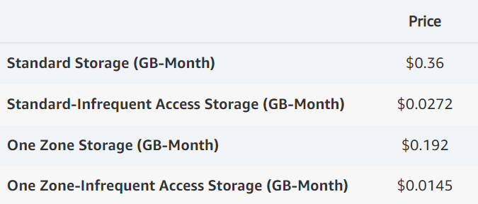
EFS Service
Storage classes
  Standard
  Standard-Infrequent Access (IA)
  One Zone
  One Zone-IA
Price
https://aws.amazon.com/efs/pricing

Slide 7
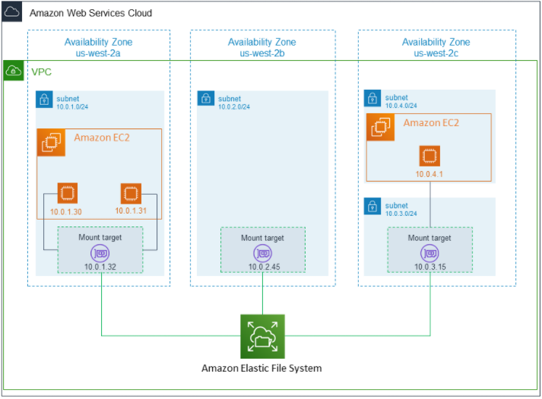
EFS Service
  Standard
    Multiple mount target points
    Poorer performance than One Zone class
    Expensive
    Working on multiple zones

Slide 8
EFS Service
  One zone
    Only 1 mount target point
    Better performance than Standard class
    Cheaper than Standard class
    Working on Only a zone

Slide 9
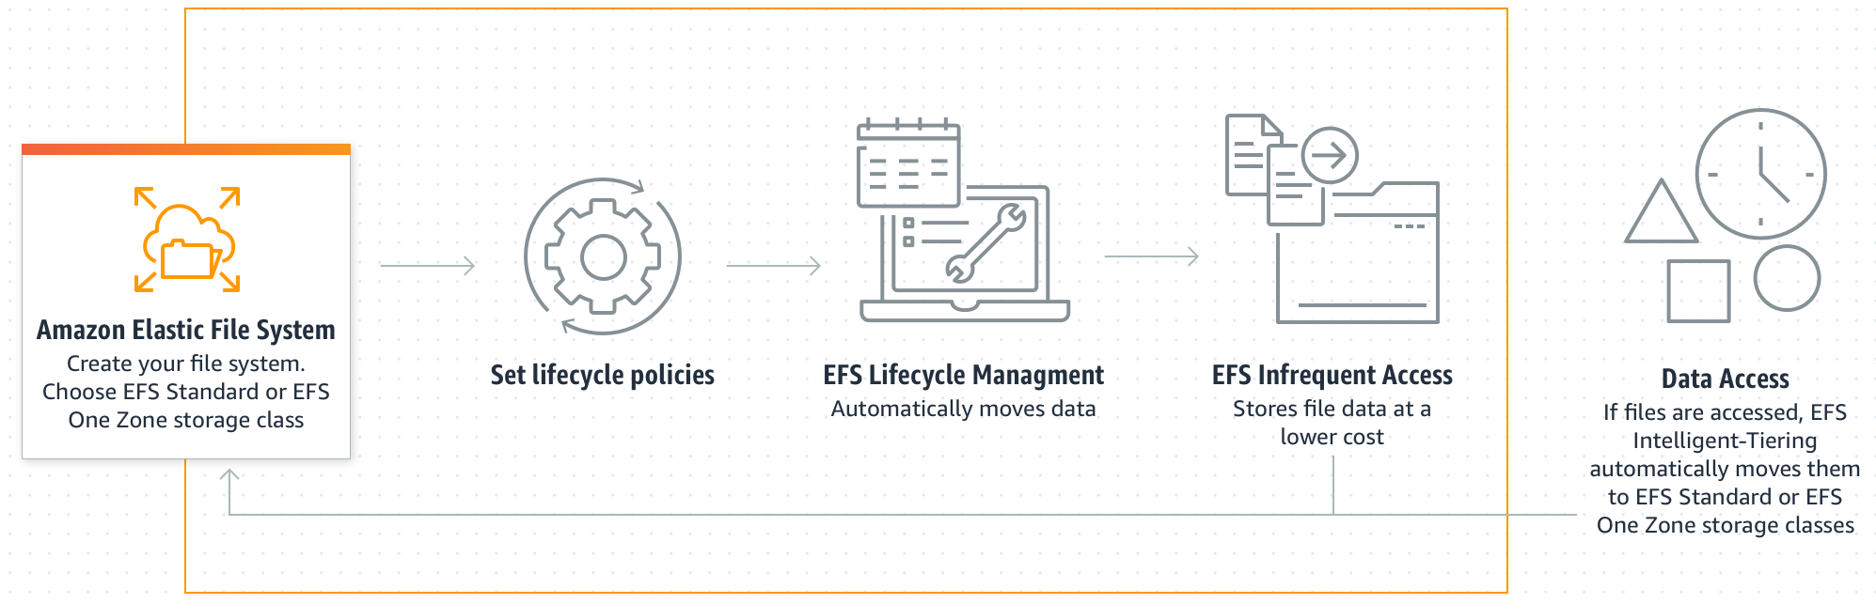
EFS Service
  Standard-IA & One Zone-IA
    Cheaper than Standard class & One Zone class
    Support Lifecycle Management to transition files to infrequent access
Lifecycle Management

Slide 10
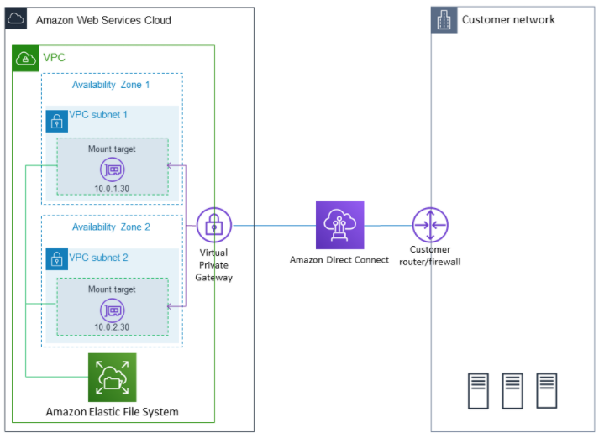
EFS Service
Connect to on-premises via Direct Connect, VPN

Slide 11
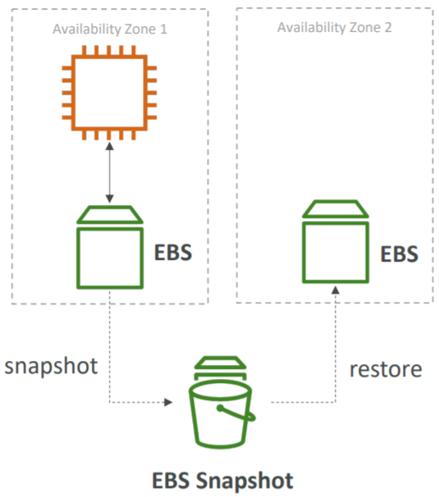
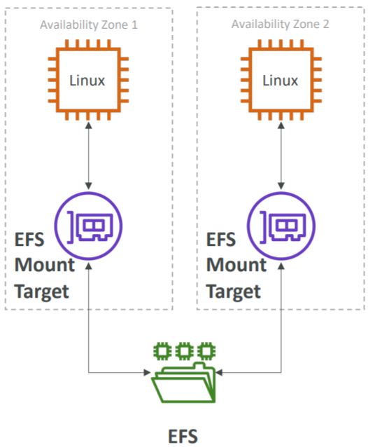
EFS Service
EFS & EBS
  EBS is a cloud disk
  EFS is a cloud disk to share data between instances
  EFS has a higher price point than EBS
EBS
EFS

Slide 12
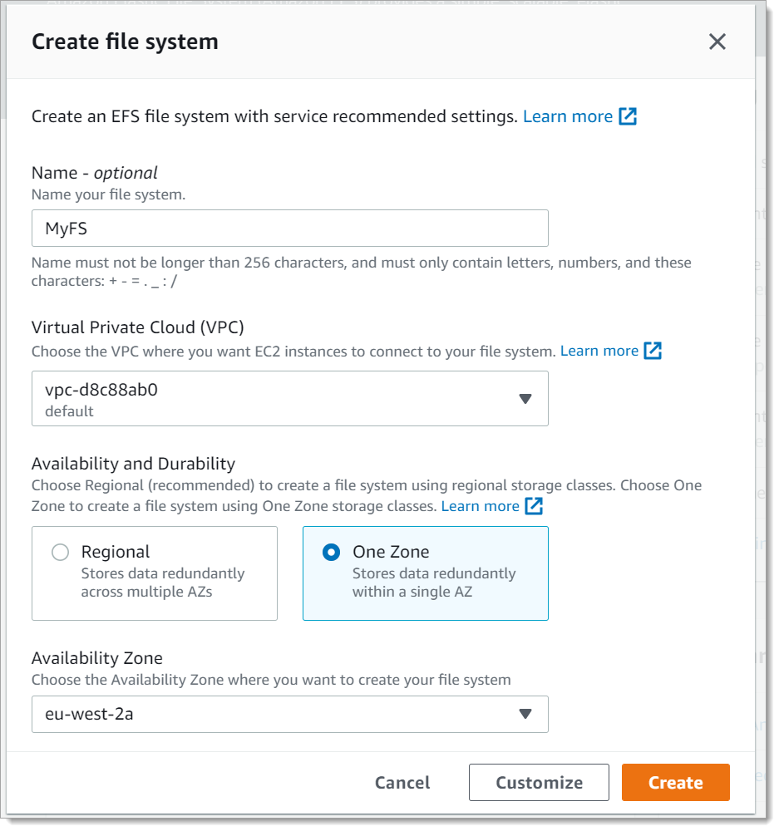
EFS Service
Demo
  Create EFS file system
  Launch a Instance
  Transfer files to EFS (using AWS DataSync)
Tutorial: https://www.youtube.com/watch?v=LWcVmfsLl8Y

Slide 13
Summary
File saving, sharing data between instances
Only support for Linux instances
Pay per use
EFS has a higher price point than EBS

Slide 14
Assignment
  Self-practice

Slide 15
Q & A
Copyright © VTI Academy All Rights Reserved

